Slide 1


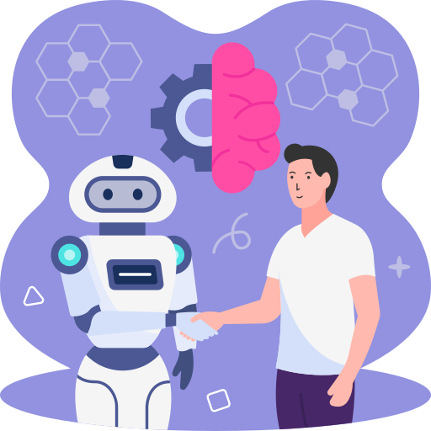

Introduction to
AI and ML

Slide 2
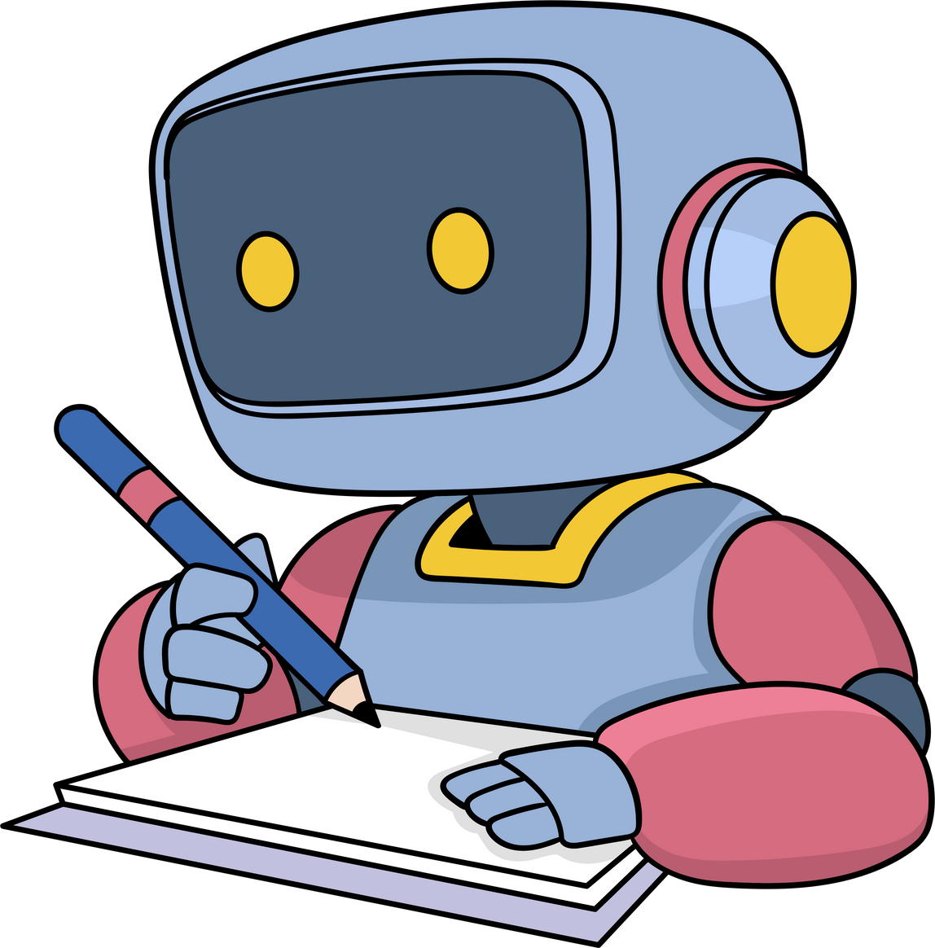
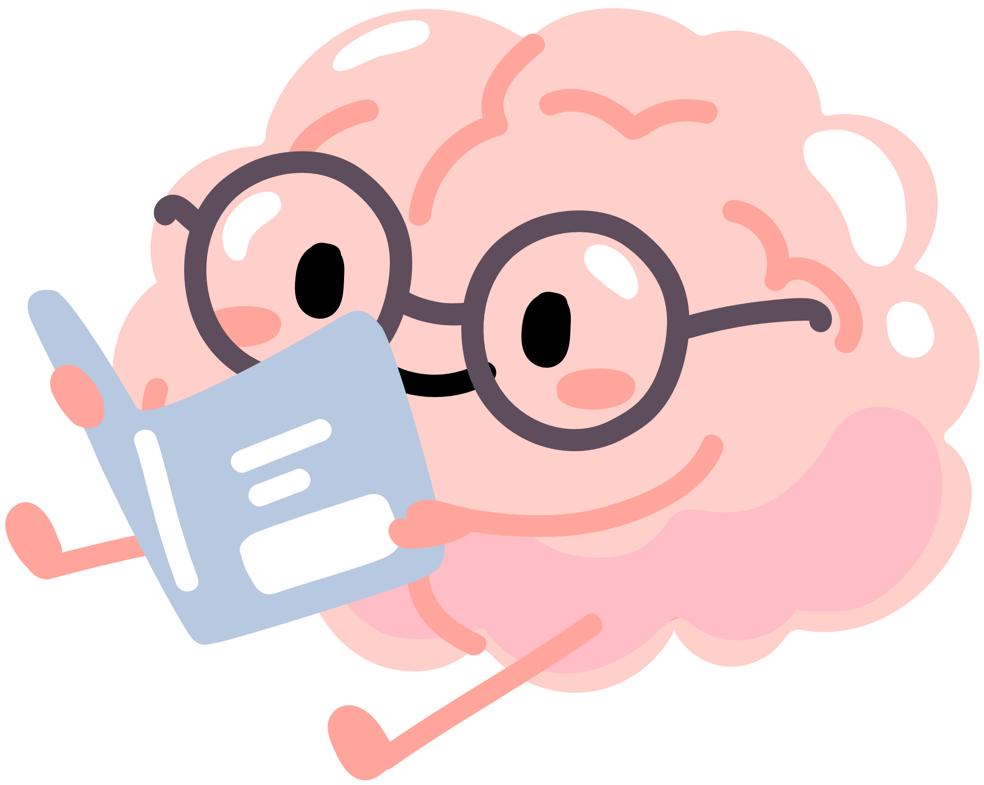
what is AI?

Slide 3
AI vs ML vs DL
Artificial Intelligence
(AI)
Machine Learning
(ML)
Deep Learning
(DL)

Slide 4
Examples of ML Tasks

Slide 5




Prediction
Is it raining?
Is it raining?

Slide 6

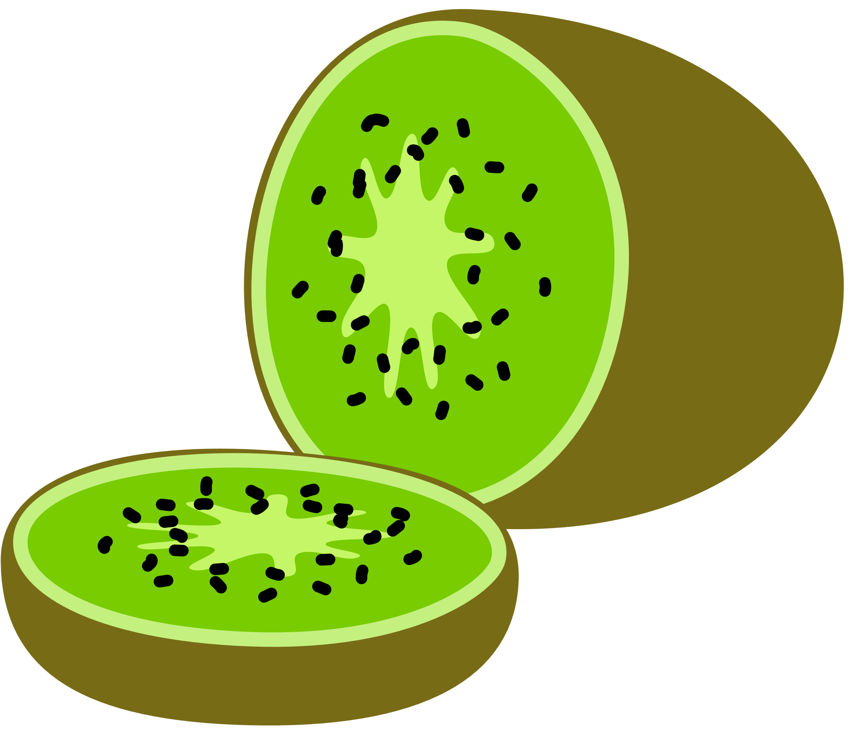



Classification!

Slide 7
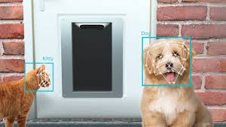
Recognition

Slide 8
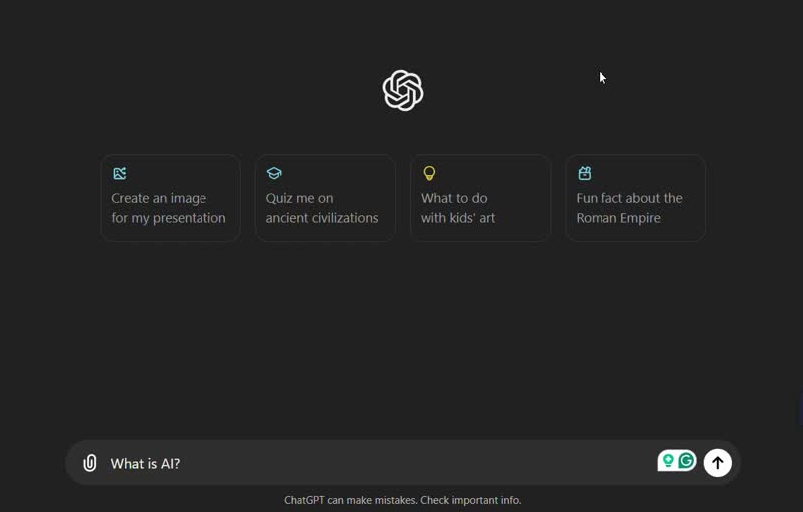
Generation

Slide 9
Examples of AI & ML Application

Slide 10


Healthcare
Medical Diagnosis
Virtual Health Assistants

Slide 11

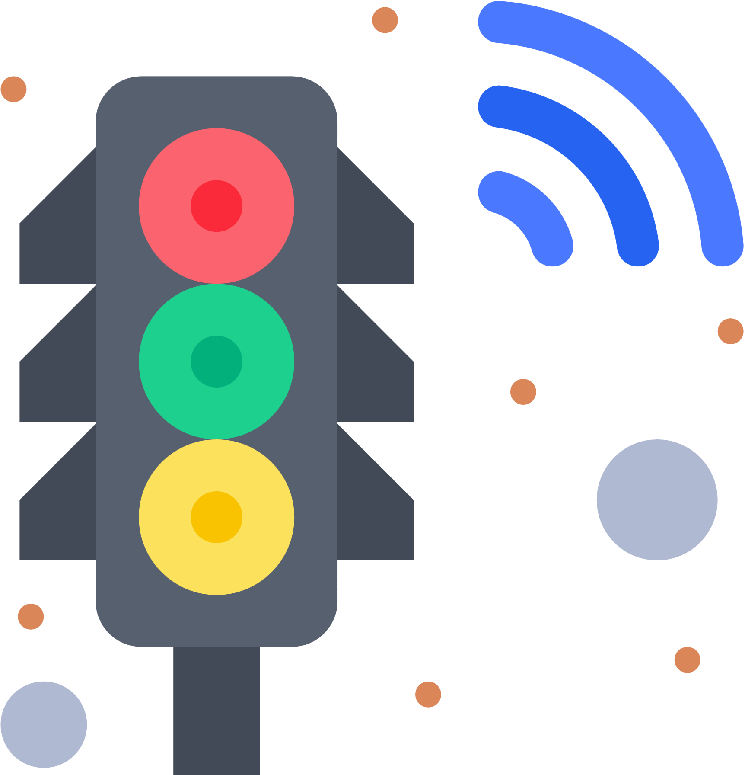
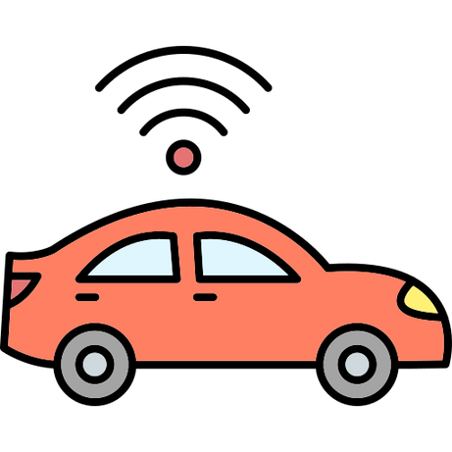
Transportation
Route Planning
Traffic Management
Autonomous Vehicles

Slide 12
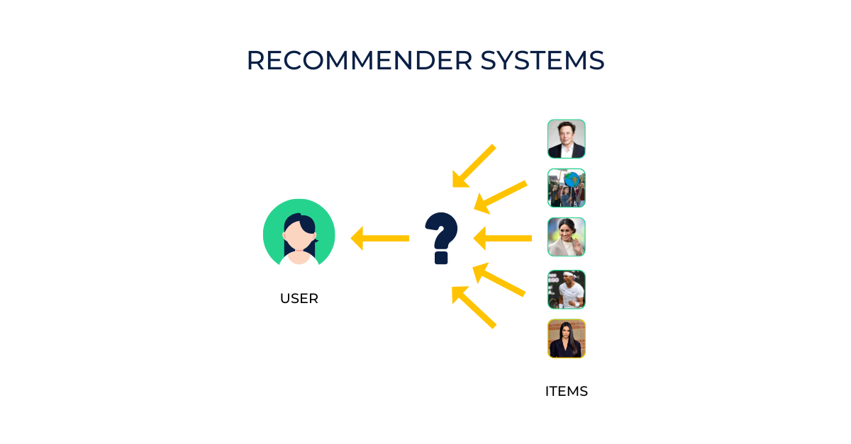

E-commerce
Recommendation Systems
Virtual Assistants

Slide 13
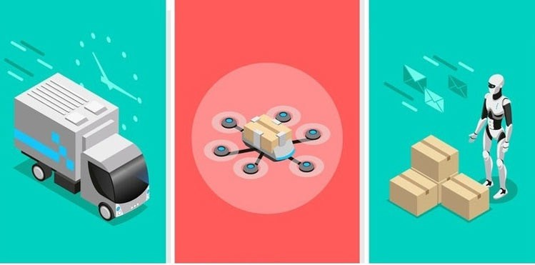
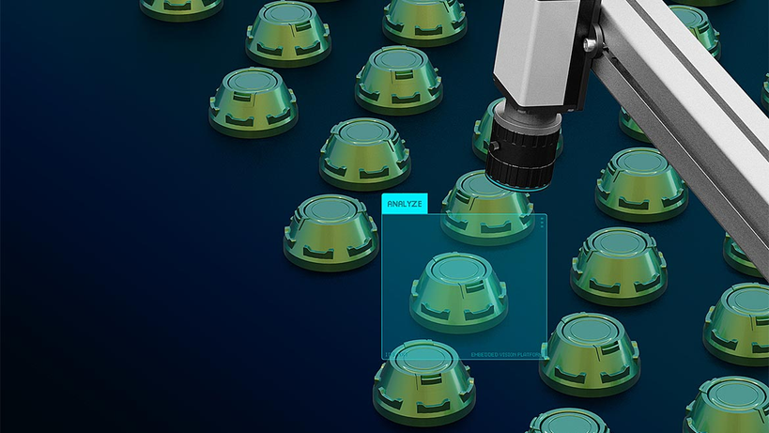
Manufacturing
Supply Chain Optimization
Quality Control

Slide 14
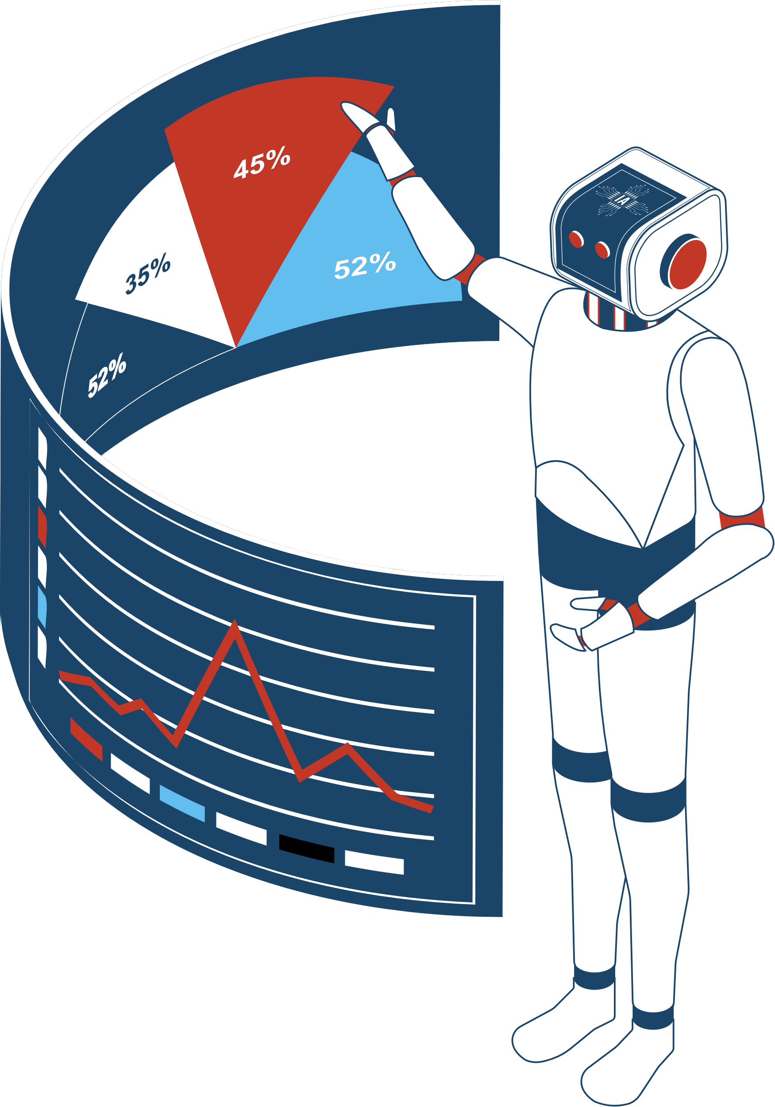
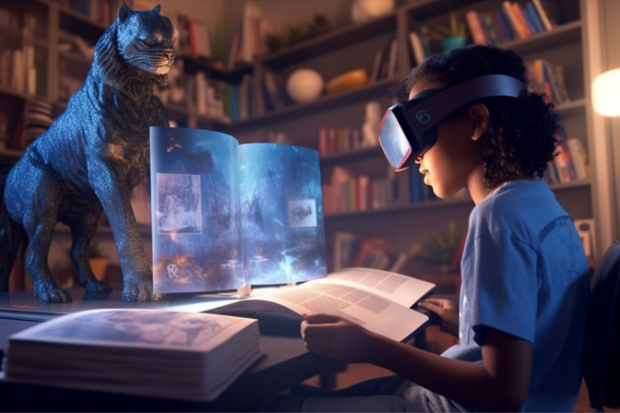
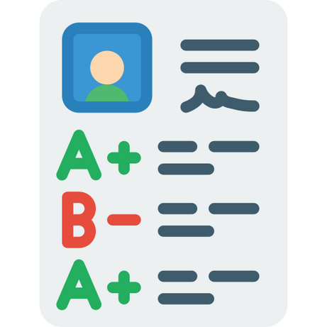
Education
Virtual Tutors
Automated Grading
Personalized Learning

Slide 15
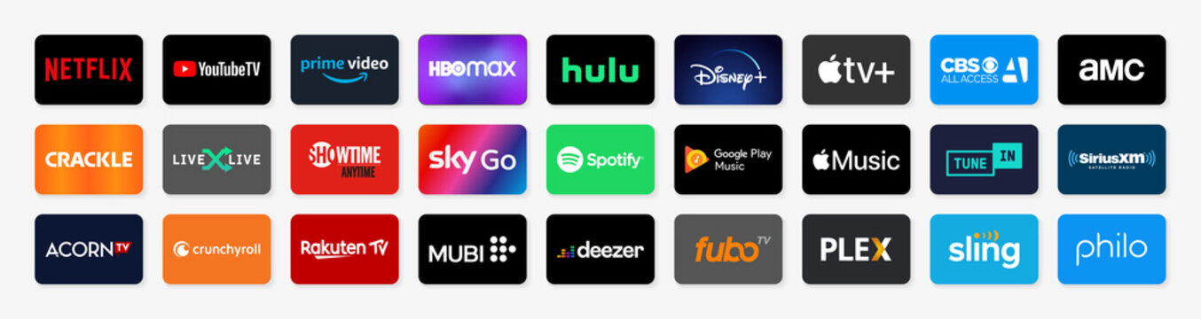

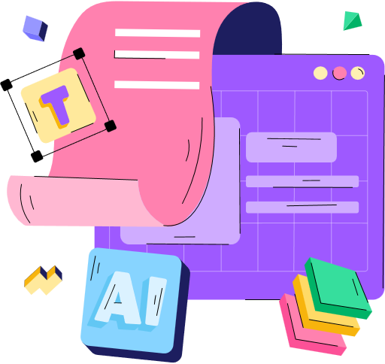
Entertainment and Media
Streaming Services
Video Game Development:
Content Creation

Slide 16
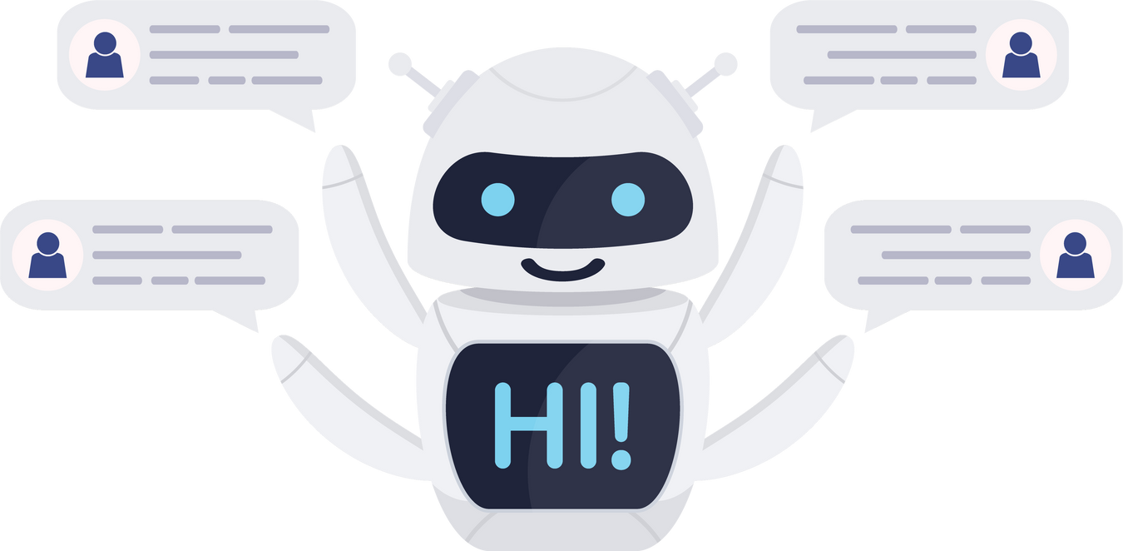

Customer Service
AI Chatbots
Sentiment Analysis

Slide 17

Security
Ahmad
Facial Recognition

Slide 18
How does it work?

Slide 19



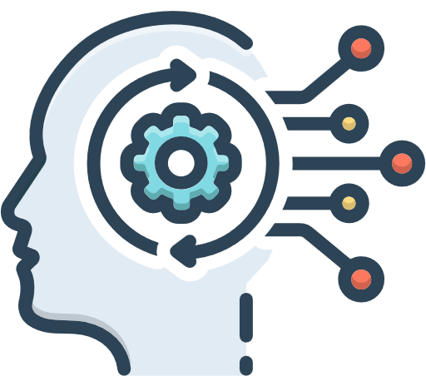
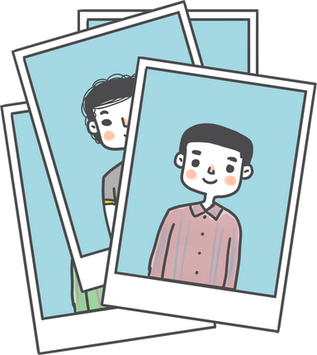
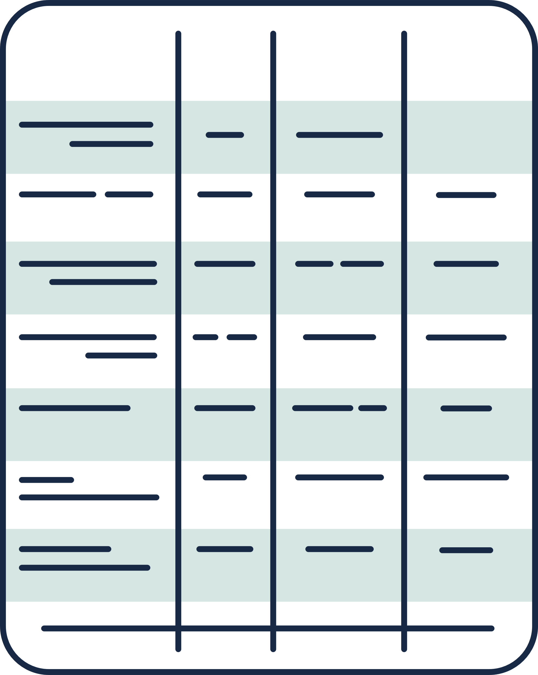






How does it work?
LOOP
Feed algorithm
Data
AI alogorithm

Slide 20


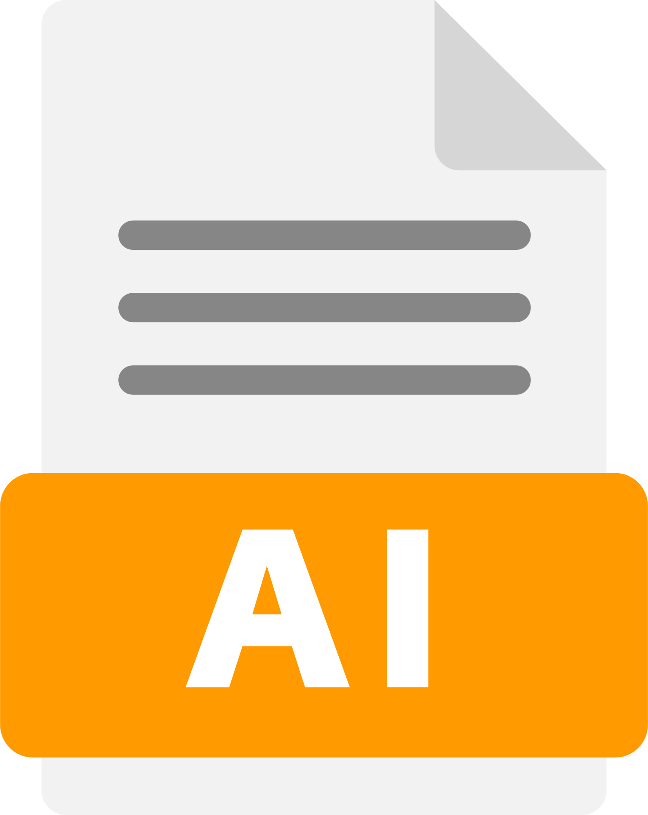
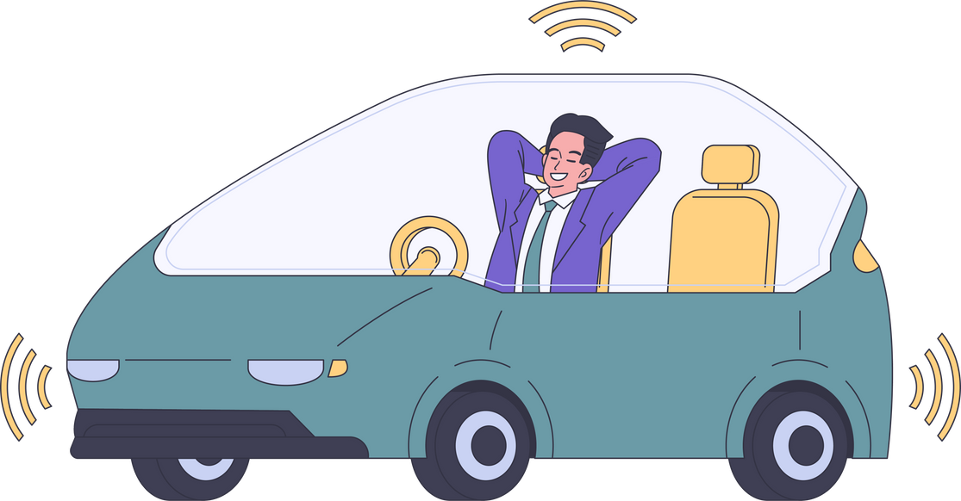


How does it work?

Slide 21
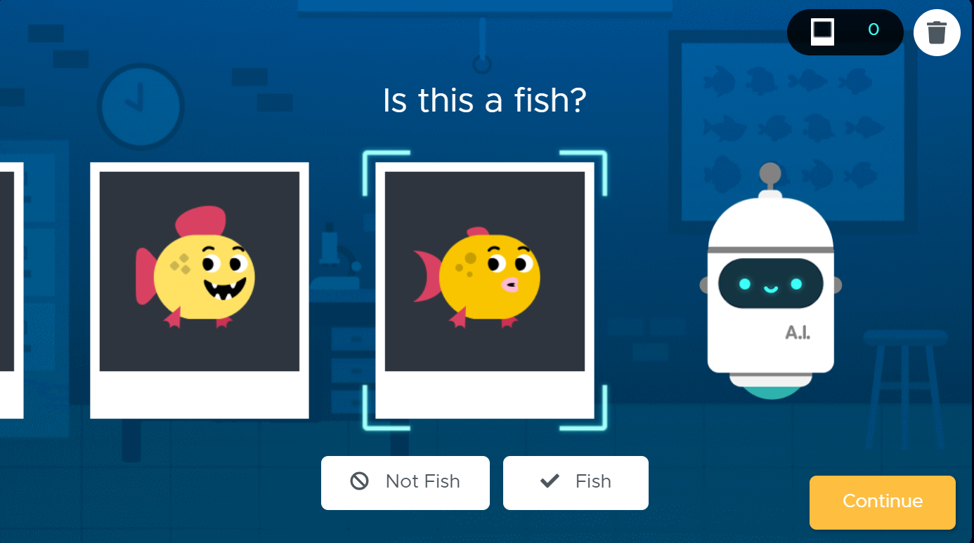
How does it work?

Slide 22
Types of data

Slide 23


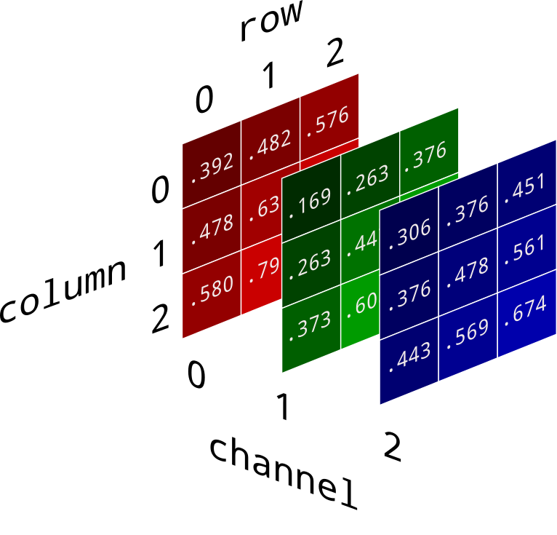

Images
row
0 1 2
0
1 2
column
0 1 2
channel
column
row
Channel(1)

Slide 24

Text
Welcome to the Al-Khwarizmi Scientific Club!
01213141516171
Welcome |  | to |  | the |  | Al-Khwarizmi |  | Scientific |  | Club |  | !
0 | 1 | 2 | 1 | 3 | 1 | 4 | 1 | 5 | 1 | 6 | 1 | 7

Slide 25


Voice
0.2 | 22.7 | 0.122 | 089 | 55.8 | 0.3 | 4.7
274 | 5.6 | 9.8 | 3.5 | 1.1 | 0.07 | 34.65

Slide 26
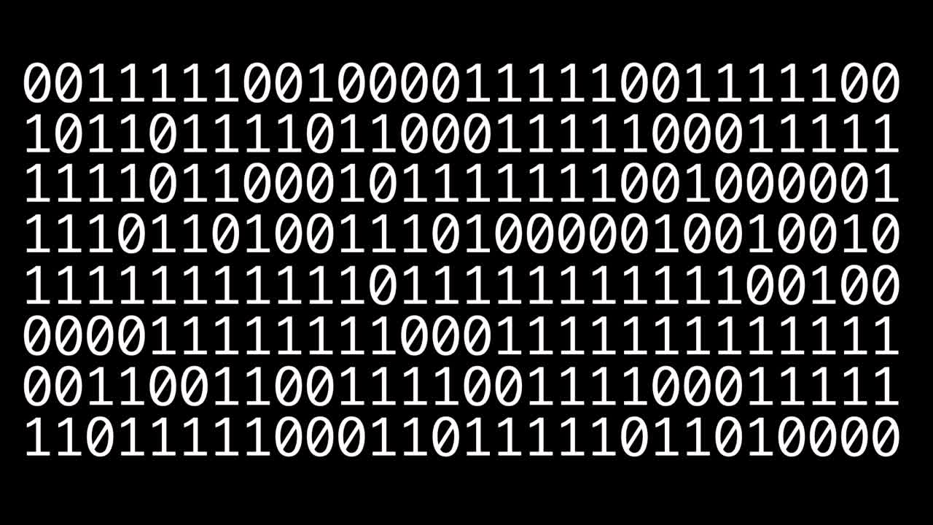
What computer see?

Slide 27
Thank You

